Slide 1
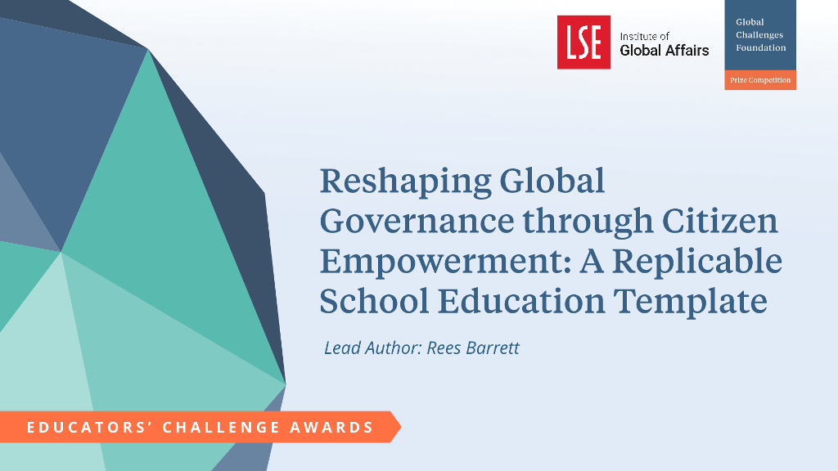

Slide 2
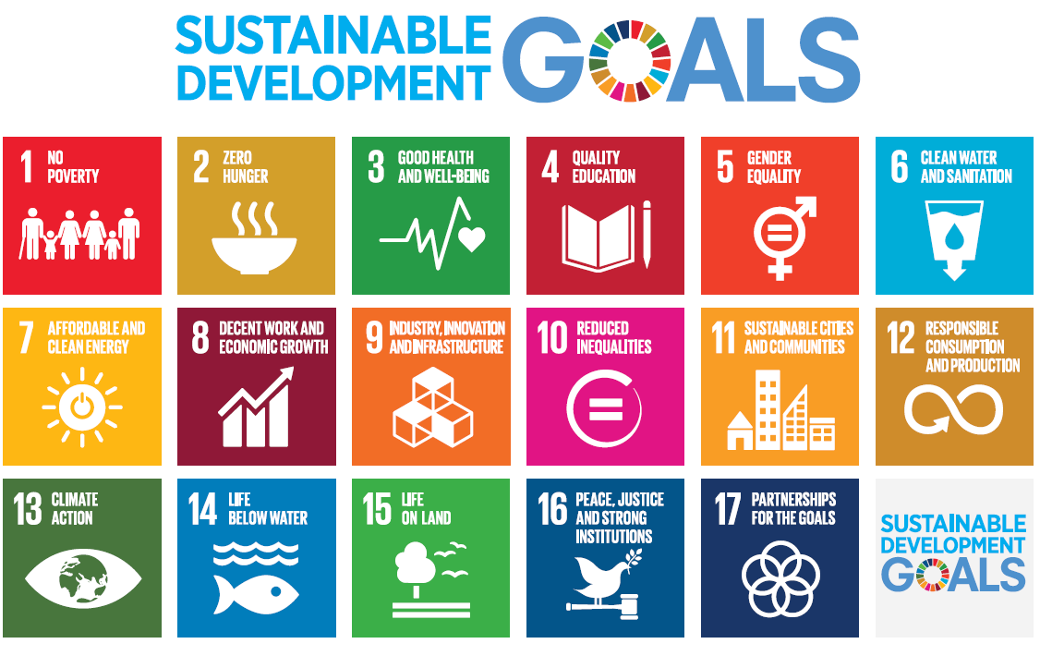
Reshaping Global Governance - UN 2030 SDGs

Slide 3

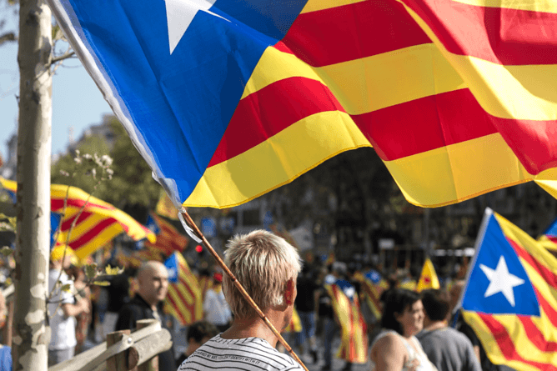
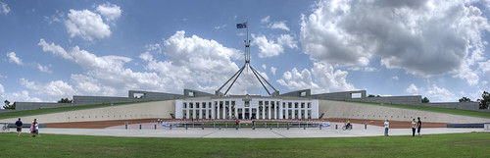
Blocking Transition to Age of Sustainable Development
National Governments Commit….. Then Forget
Vested Interests work … for ‘Business as Usual’
‘We The Peoples’ … majority see globalism as the problem

Slide 4

Community Education
Peace and Security
Positive Impacts of Global Cooperation
Civil Society Synergy Through SDGs
Human Rights
Gender Equality
Environment

Slide 5
Shared
Planning Framework
Targets and Indicators
Leave
No-one Behind Principle
Global Goals Planet
People
Prosperity
Human Rights and Responsibilities
Individual Actions:
Think Global
Act Local
Citizen Agency: Shaping Change

Slide 6
GCEd TEMPLATE
2. Schools Network
K to 12
7. Events and Partnerships
3. Curriculum Alignment and
Targeted Resources
1. International Benchmarks
6. Program Accreditation
4. Student Parliaments
5. Awards (Teachers and Students)

Slide 7

TEMPLATE VALUE PROPOSITION
1. Reframing rather than reforming curriculum
2. SDGs – student agency and transformational competencies (OECD)
3. SDGs – framework for project design and management
4. Problem-solving – students integrate and apply learning
5. SDGs – emotional engagement for all students
Students ‘from overwhelmed to empowered’

Slide 8
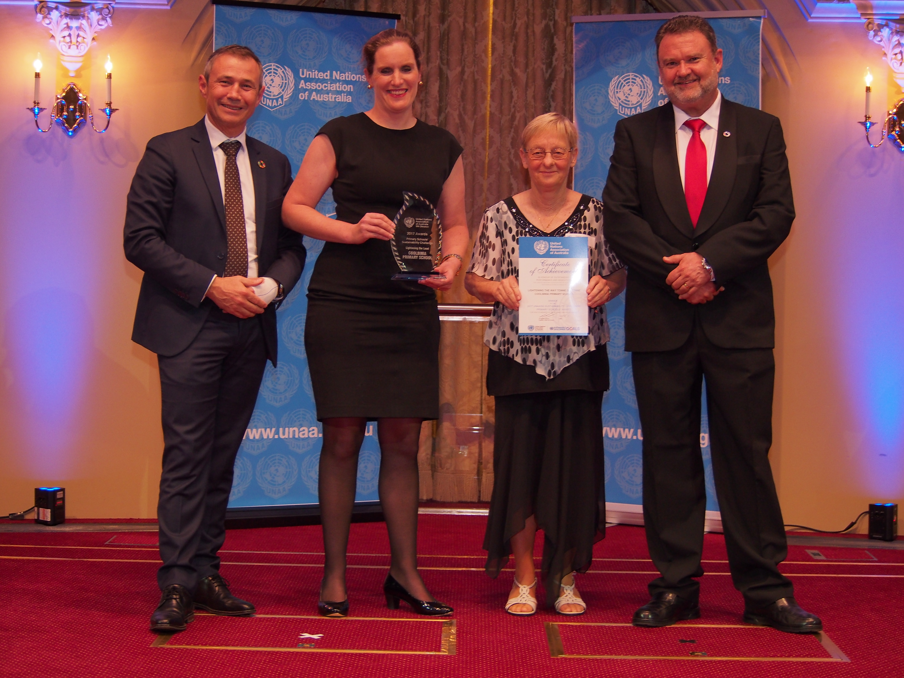
IMPACT – Quantitative Indicators
Number of schools/teachers (from 0 to 35)

Slide 9
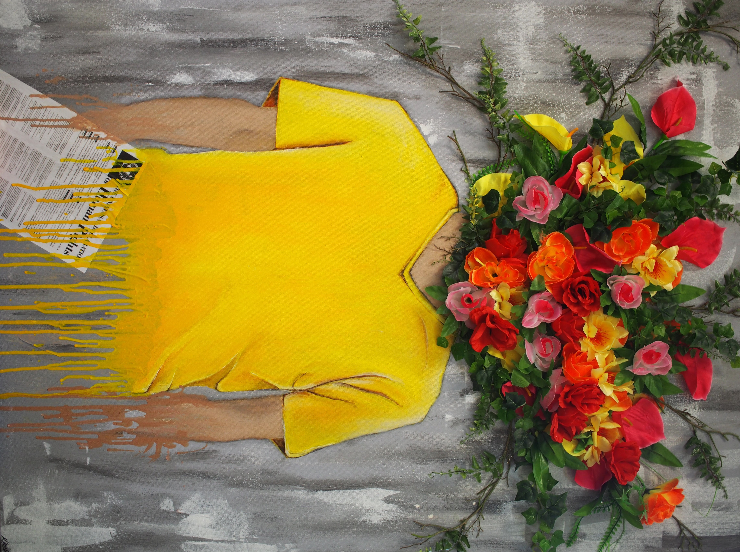
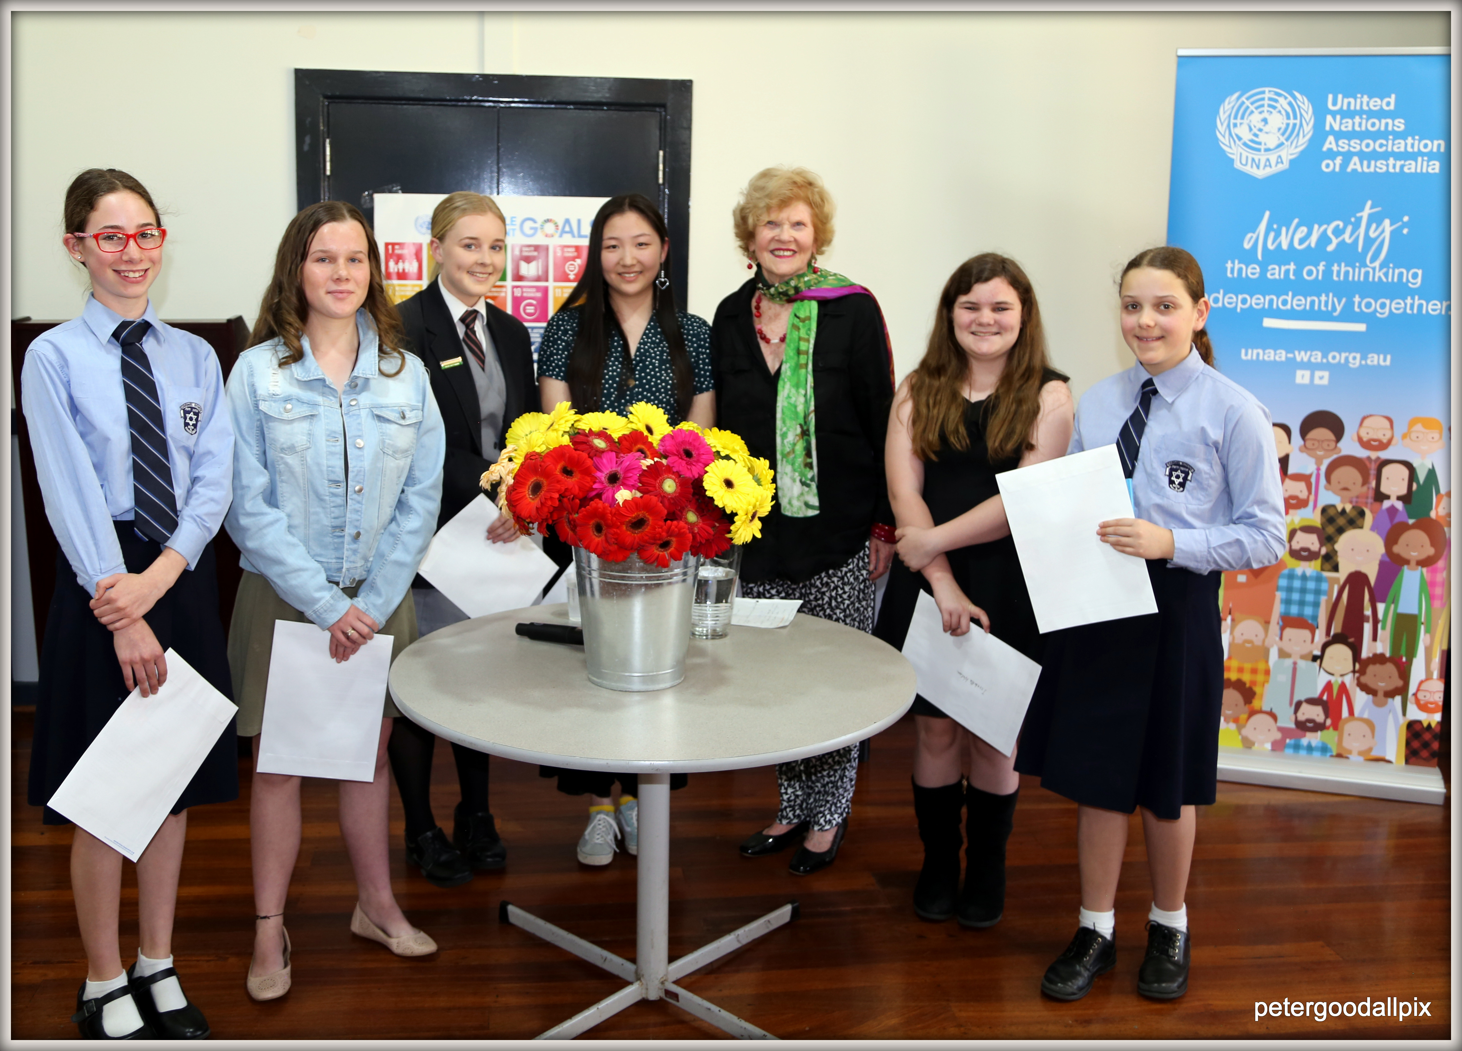
IMPACT – Quantitative Indicators
2. Level of student participation (three fold increase 2017 to 18)

Slide 10
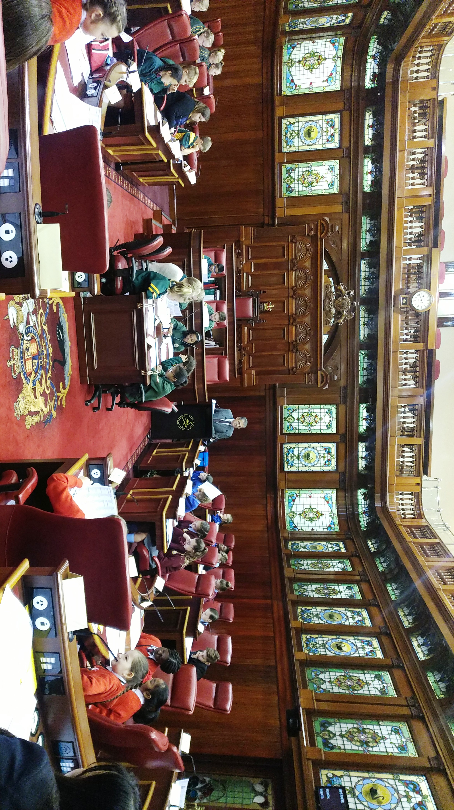
IMPACT – Quantitative Indicators
3. Student Parliament Evaluations (consistently high/very high)

Slide 11
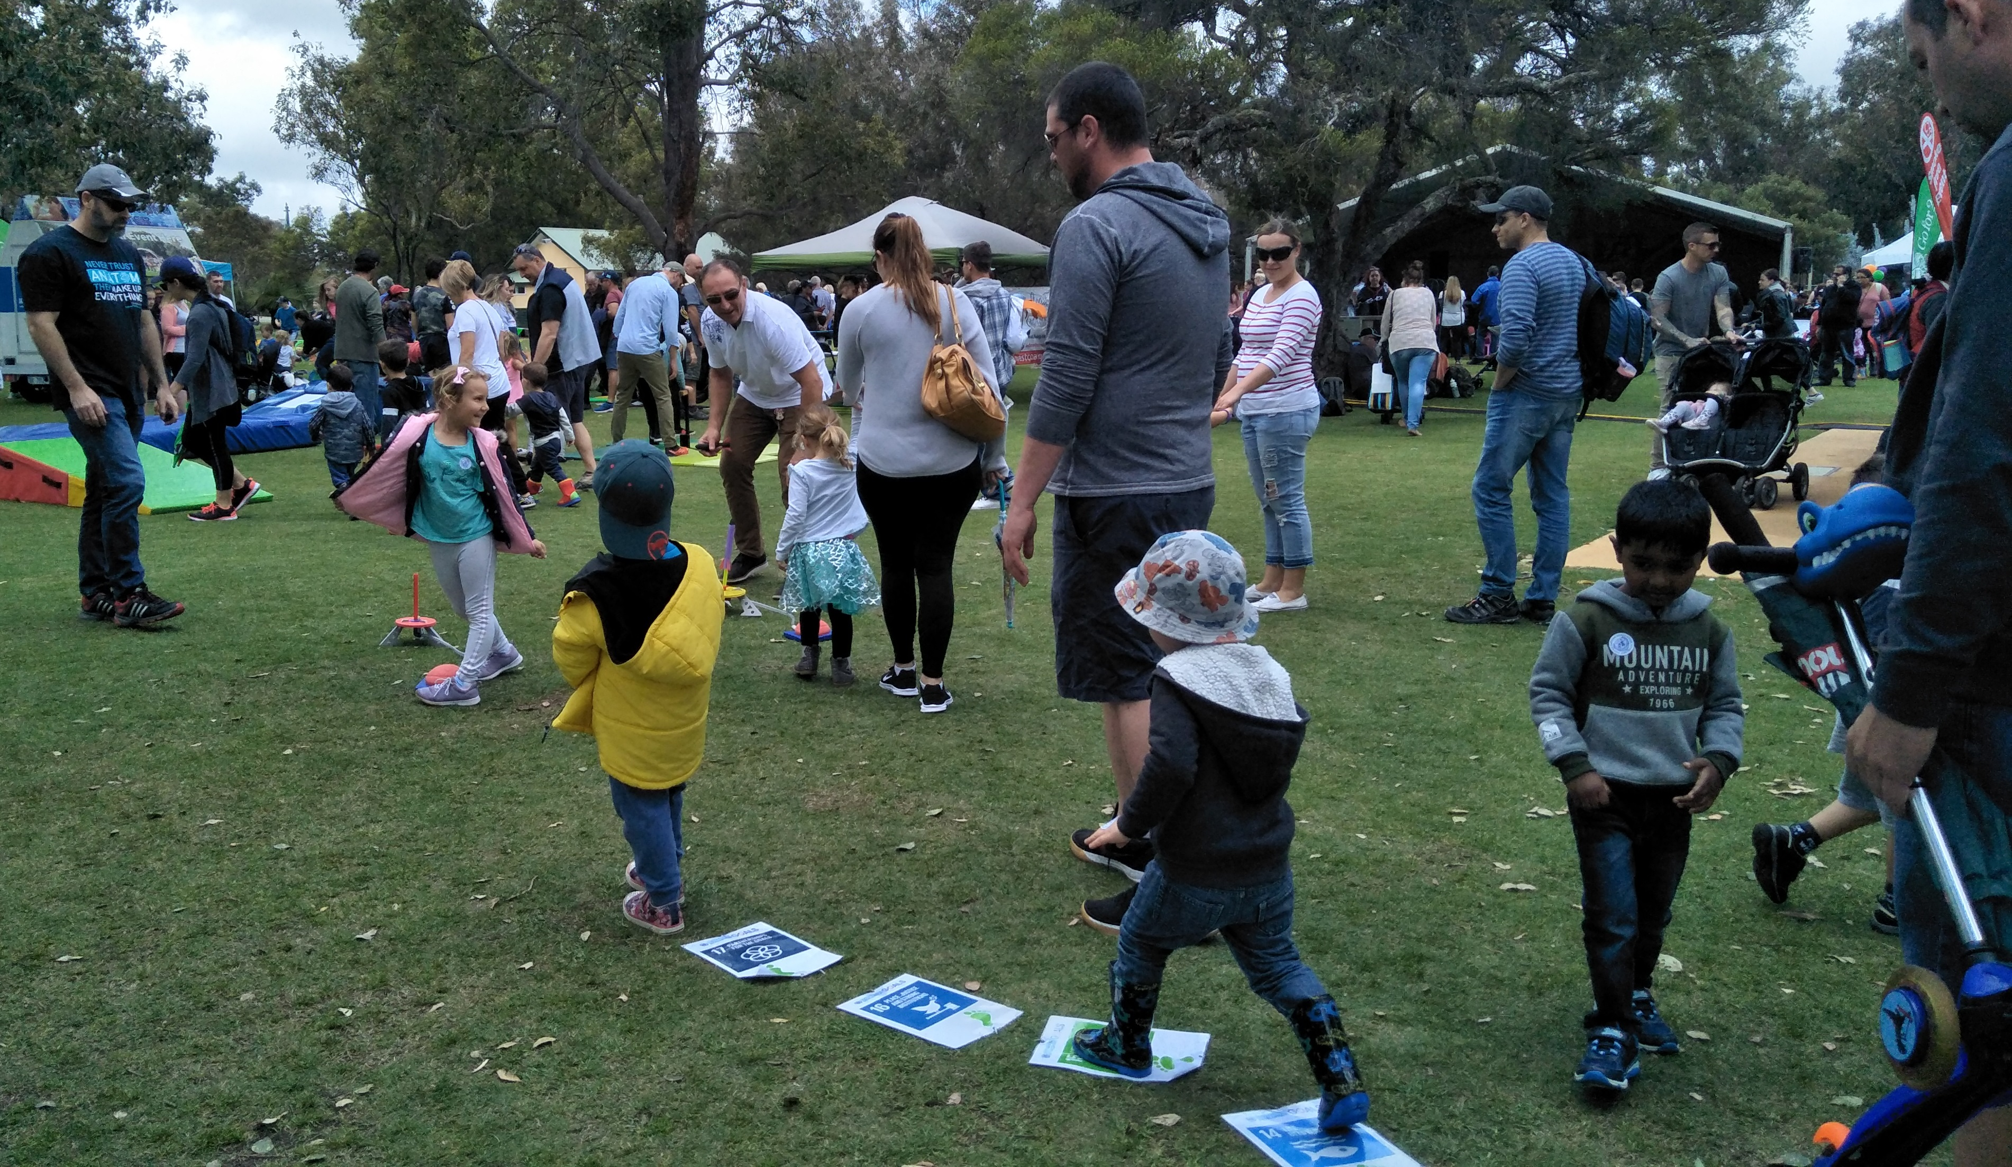
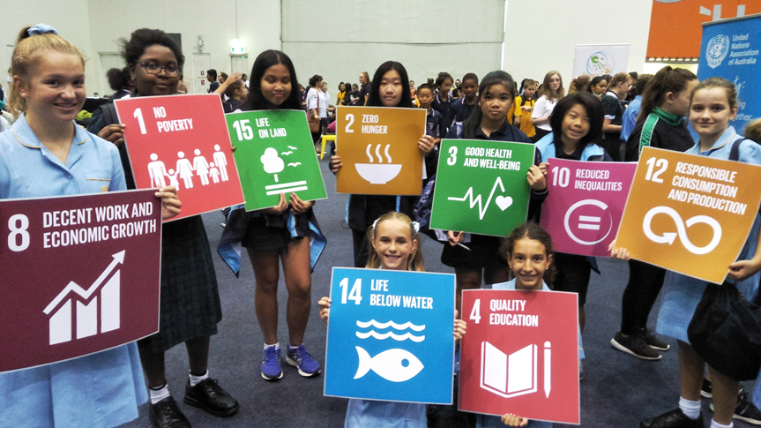
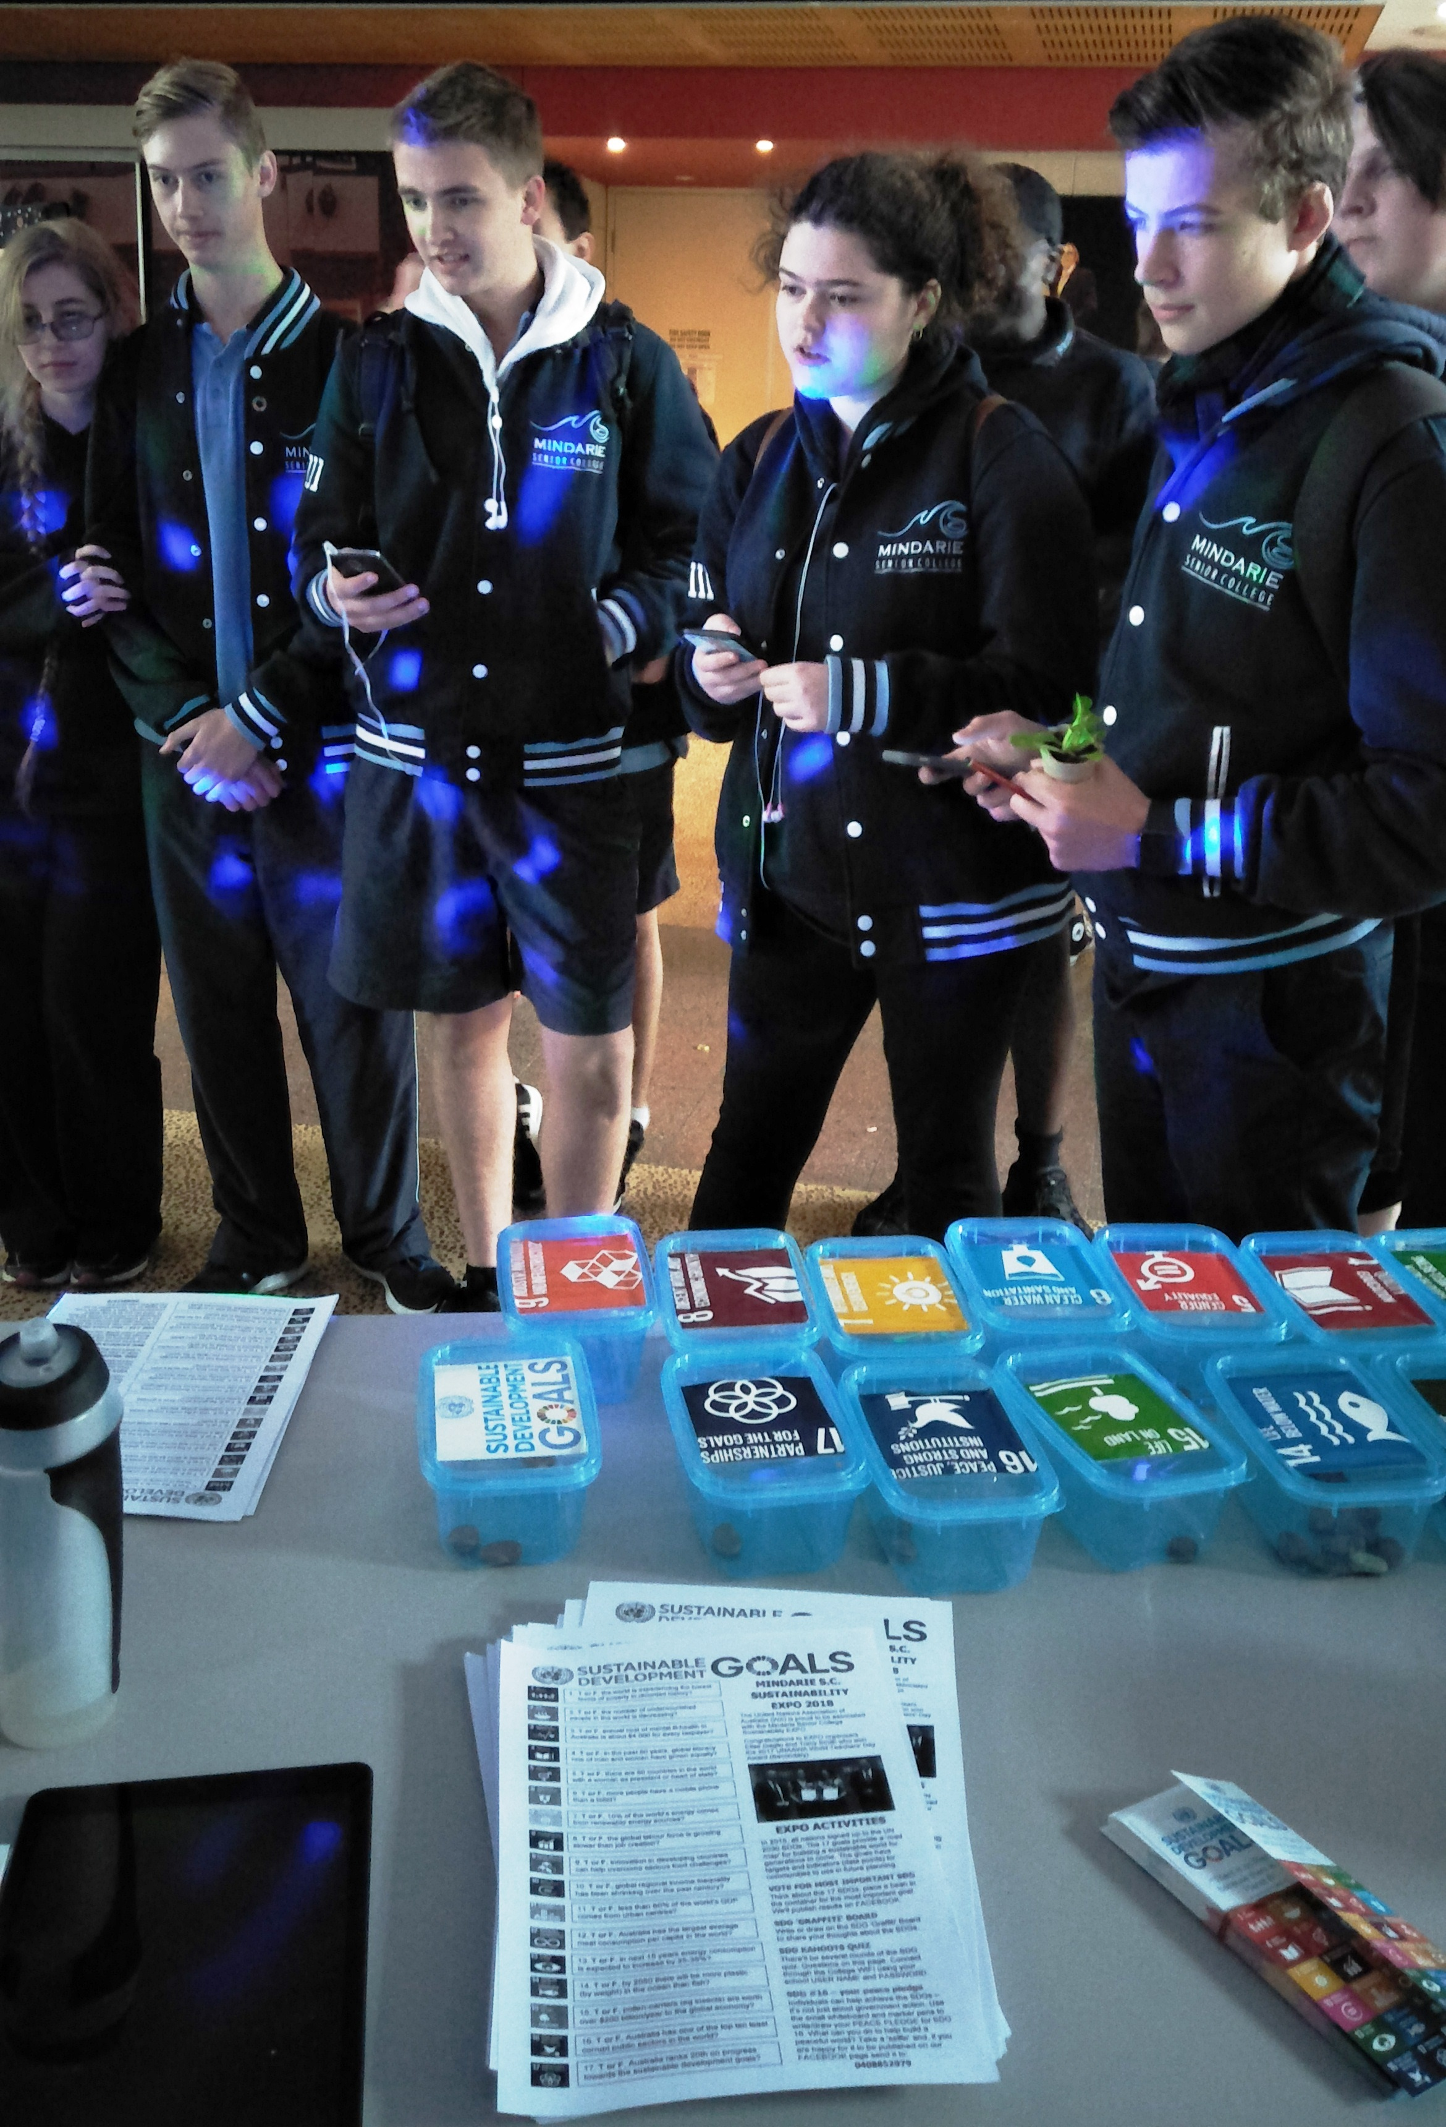
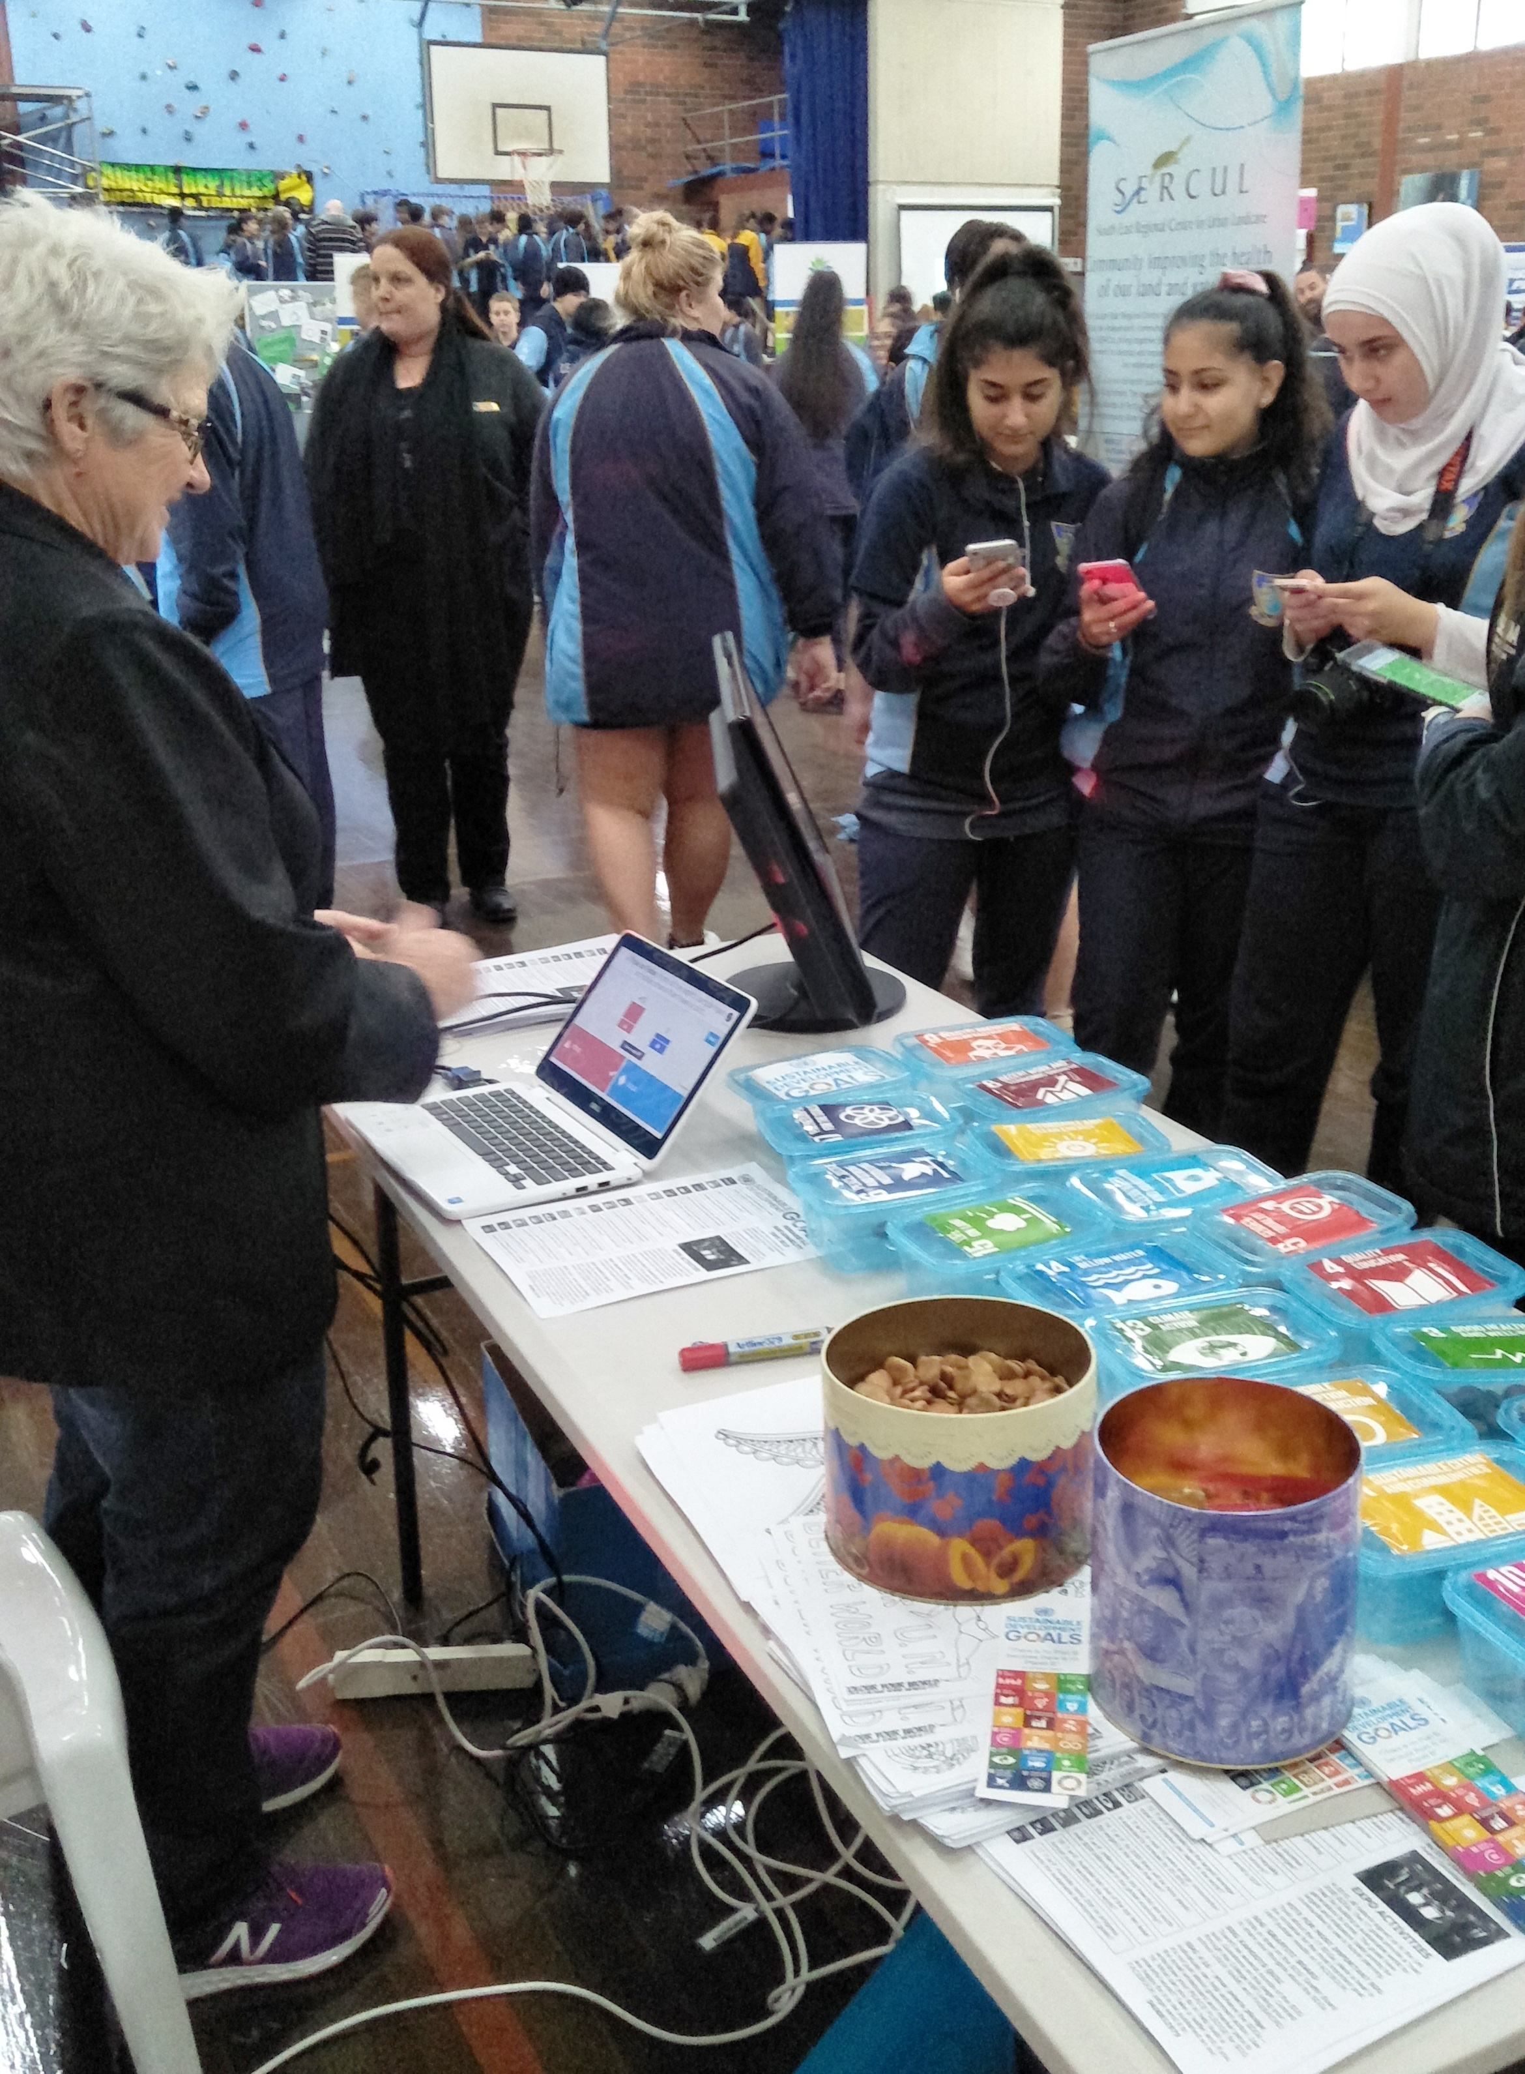
IMPACT – Quantitative Indicators
4. Number of event interactions
(School Expos & Family Fun Days)

Slide 12
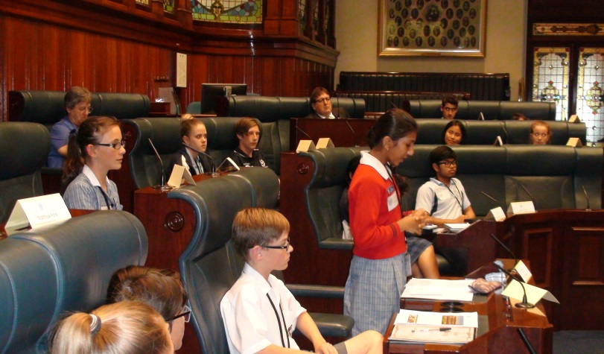
IMPACT – Quantitative Indicators
5. Social Media (2019 Global Goals Projects over 700 views You Tube)

Slide 13
IMPACT – Qualitative Indicators
Community comments:
“Your work helps "make sense" amongst turmoil in this world”.
“I’m concerned for this student’s well-being if he is not included.”
Teacher comments:
"It was inspiring to learn about last year's winning projects from the students who actually led them."
Parent comments:
"Parents who supervised our students came back inspired and committed to supporting the students' Global Goals project."
“Thank you for this opportunity. It means so much to Kiki.”

Slide 14
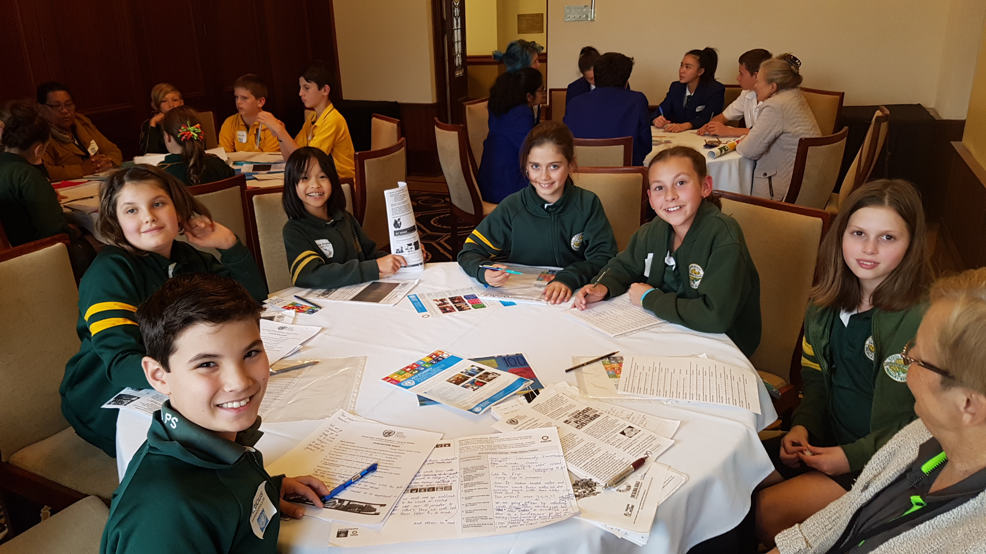
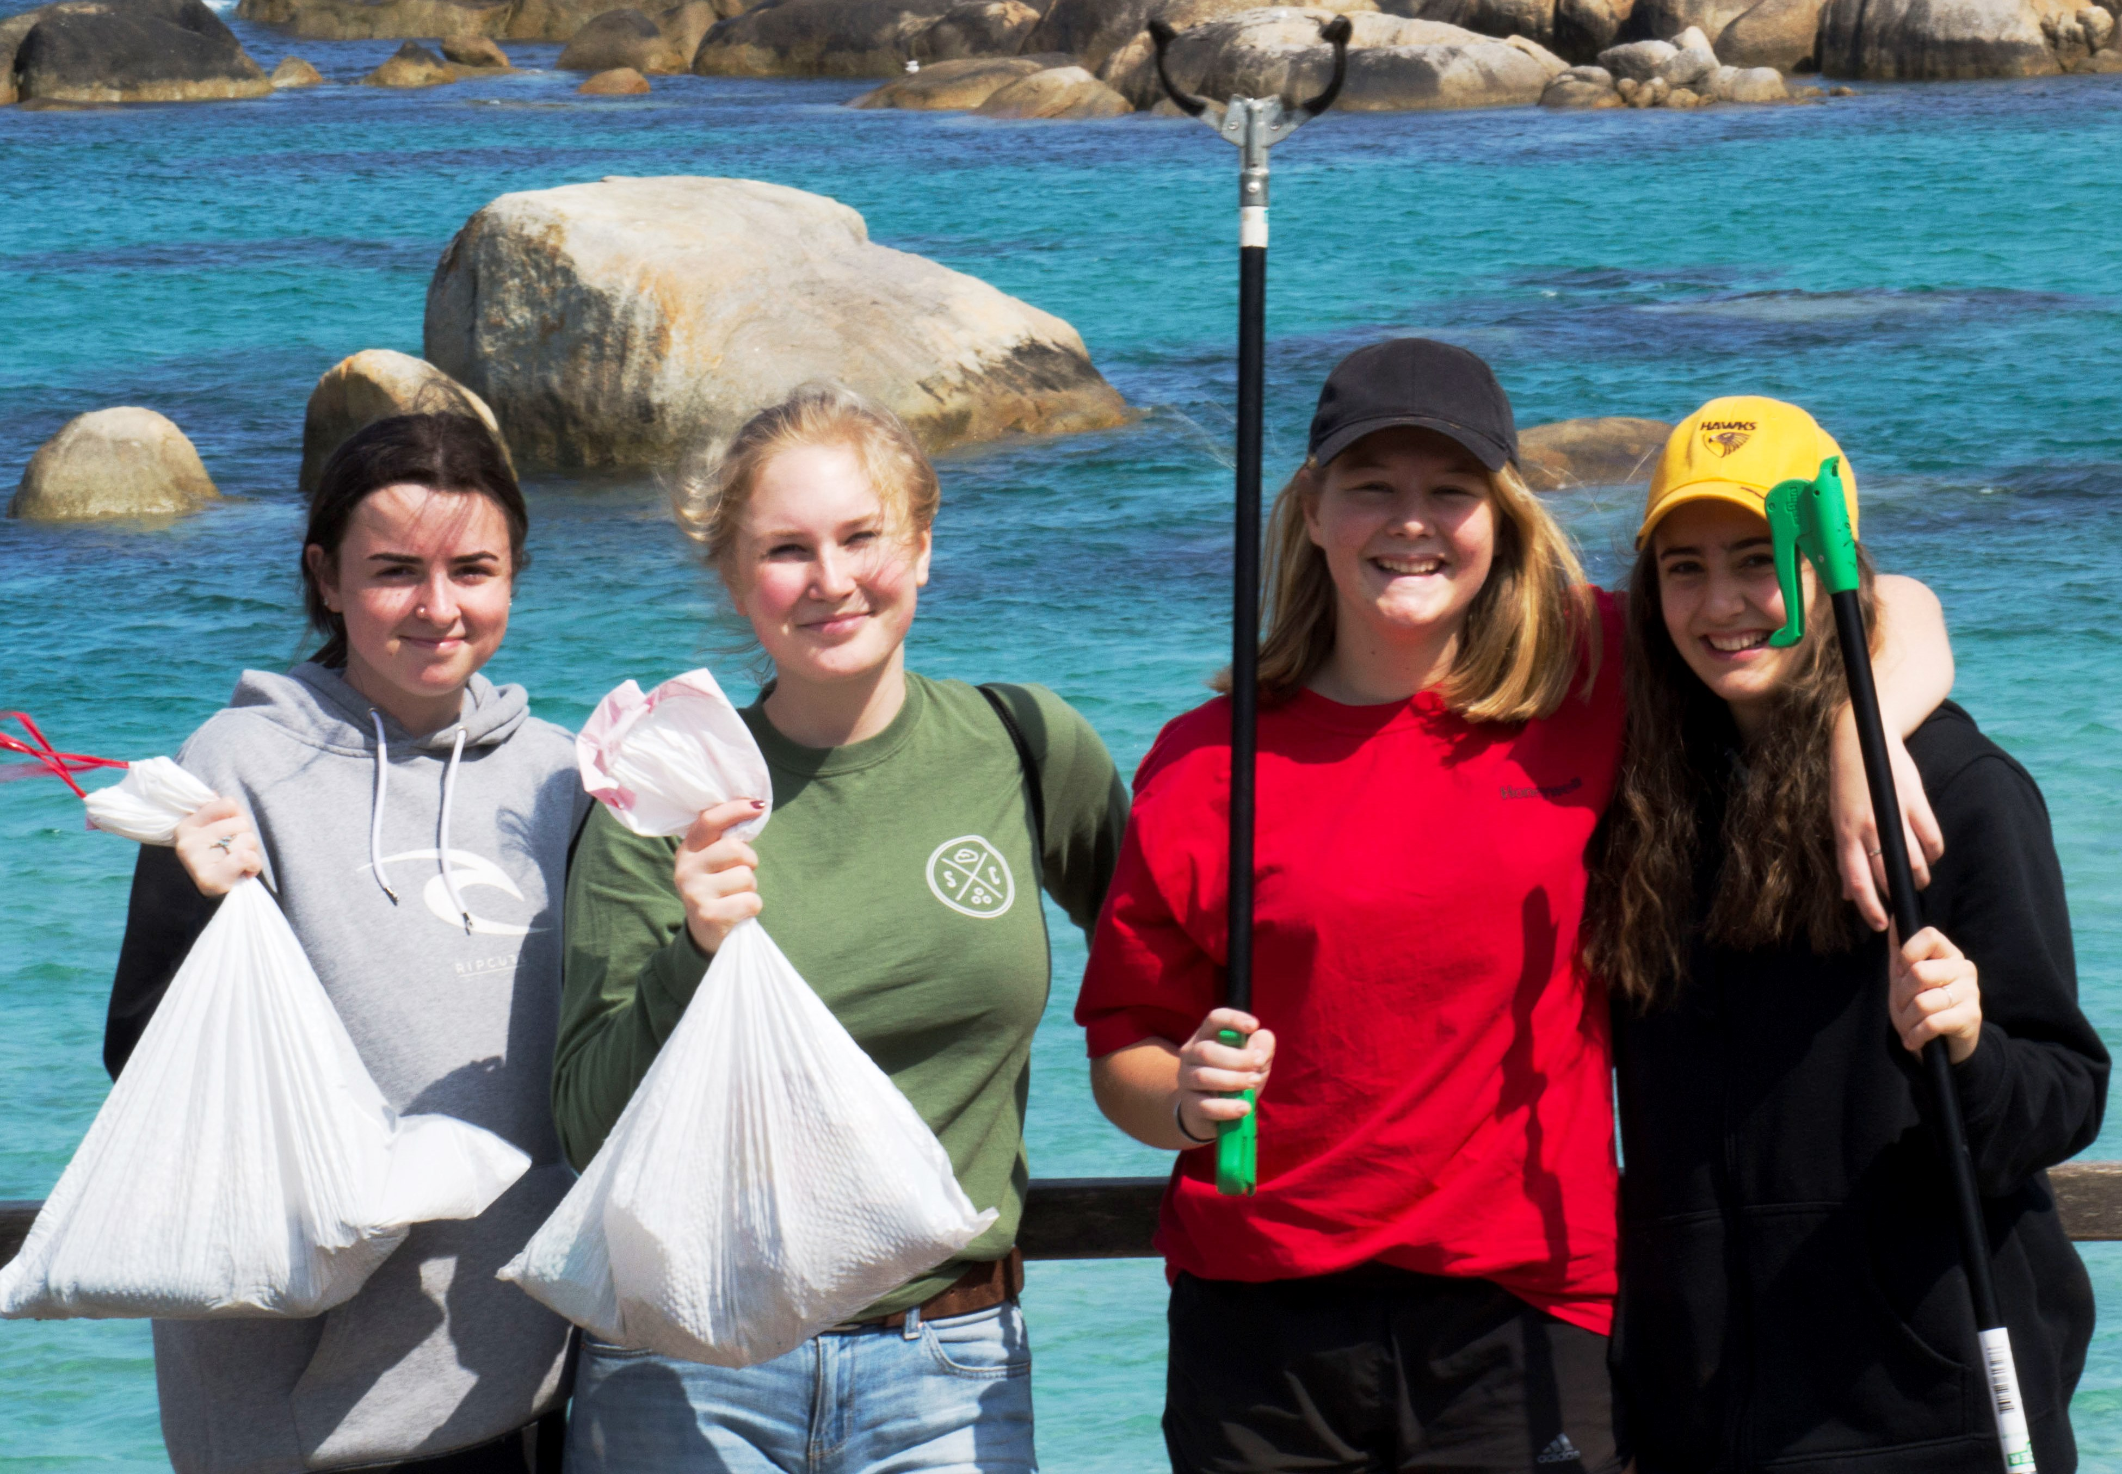
IMPACT – Qualitative Indicators Student comments:
“… I realised I could actually make a difference.”
“I learned many ways I can make a difference on this planet and make my ideas a reality.”
“It’s easy to feel pessimistic, but experiences like today and adults wanting to know what we think makes me optimistic.”

Slide 15
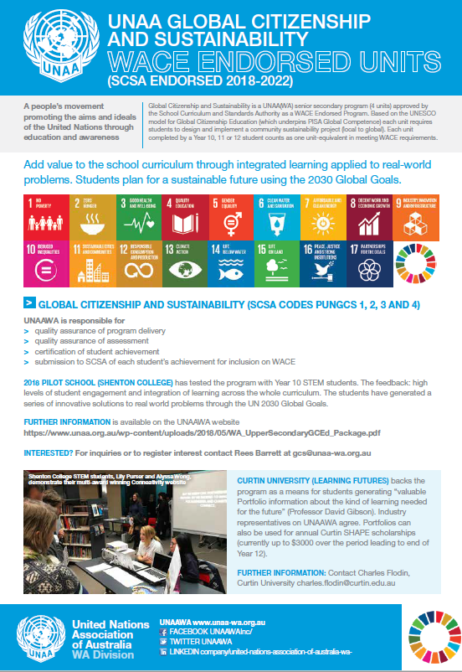
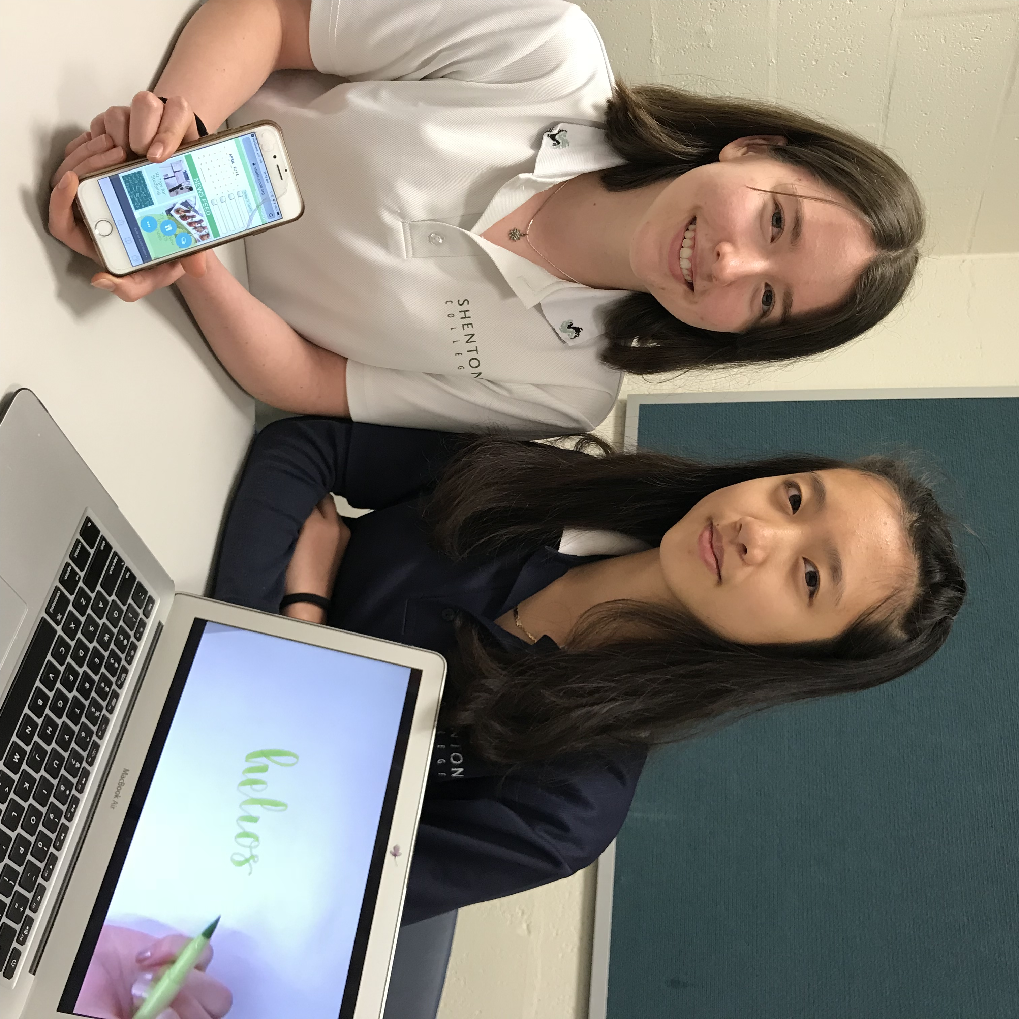

Slide 16
IMPACT – Academic Research
Young Persons’ Plan for the Planet research:
“…a paradigm mindset shift
from ‘overwhelmed’
to ‘understanding’
to empowerment’
thus achieving a sustainability mindset.”
Ian Chambers (Australian National University) et al

